Slide 1
Section 6.2. Volume

Slide 2

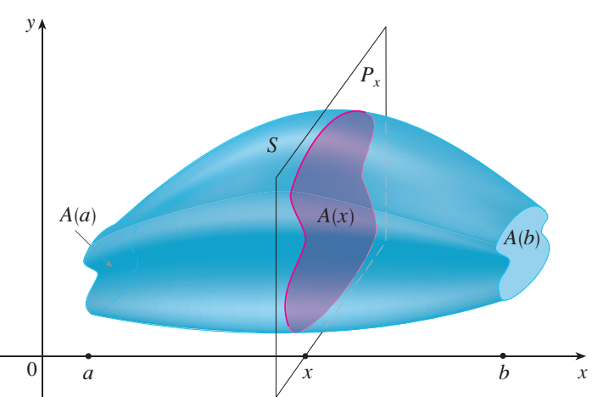
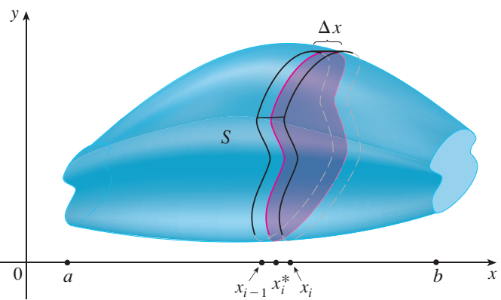
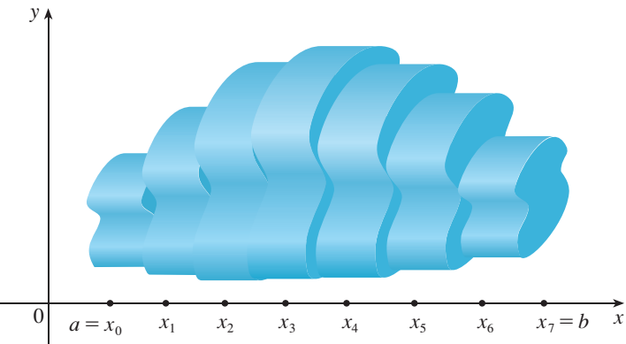

Volume of a solid

Slide 3

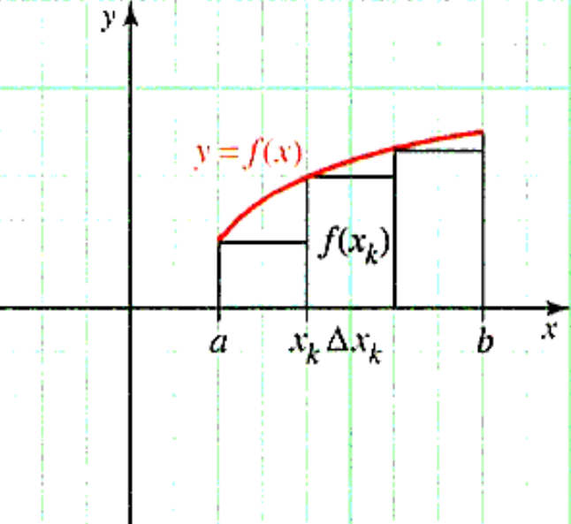
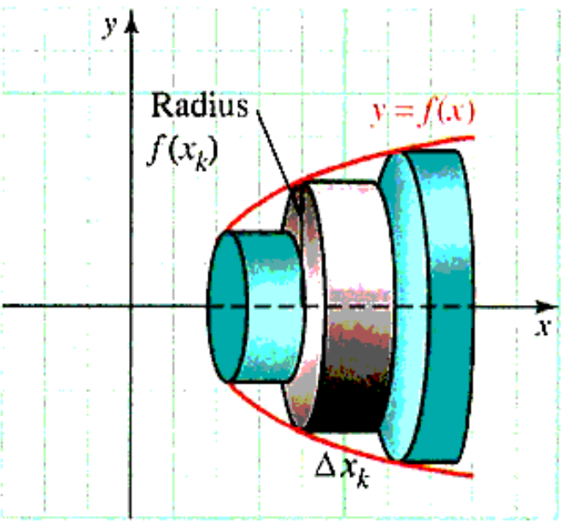


Dish Method

Slide 4
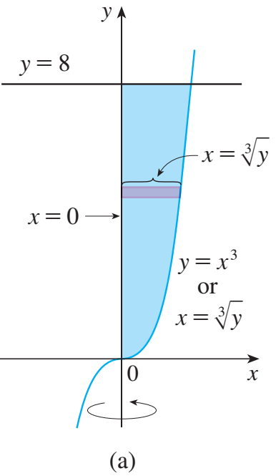
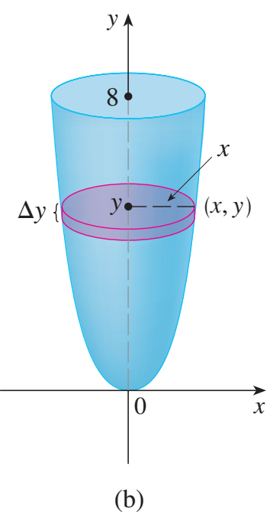
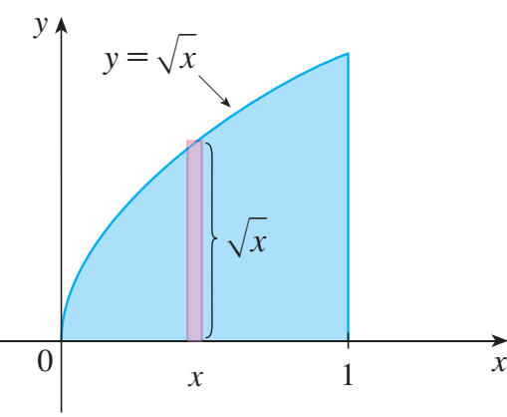
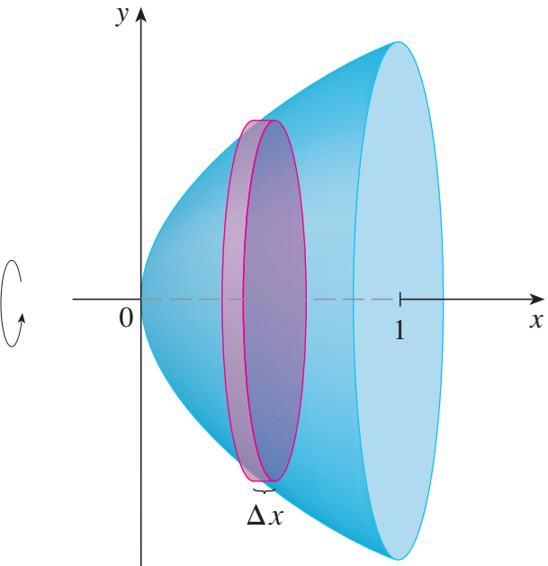
Dish Method: Examples

Slide 5
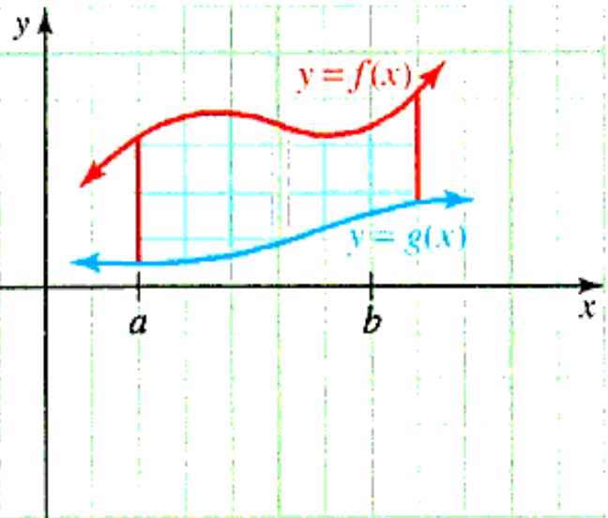
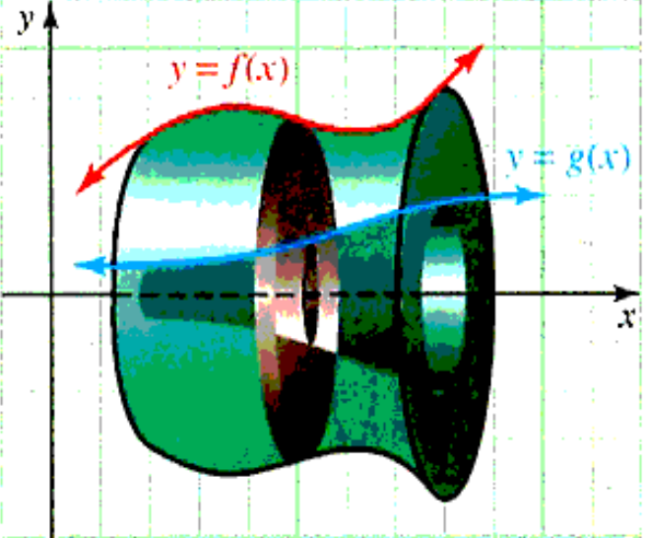

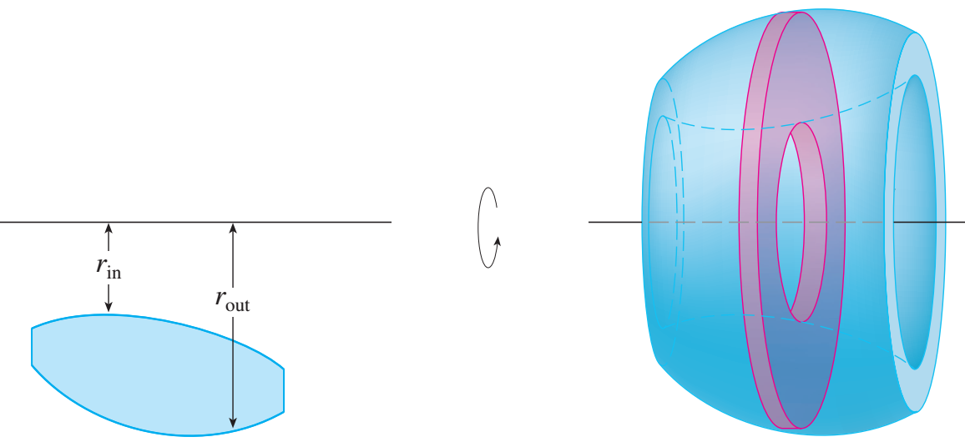
Washer Method
f, g are continuous; f(x) ≥ g(x) ≥ 0 on [a, b]
D: bounded by y =f(x), y=g(x), x = a, x = b
Let D revolve about x-axis. The volume?

Slide 6
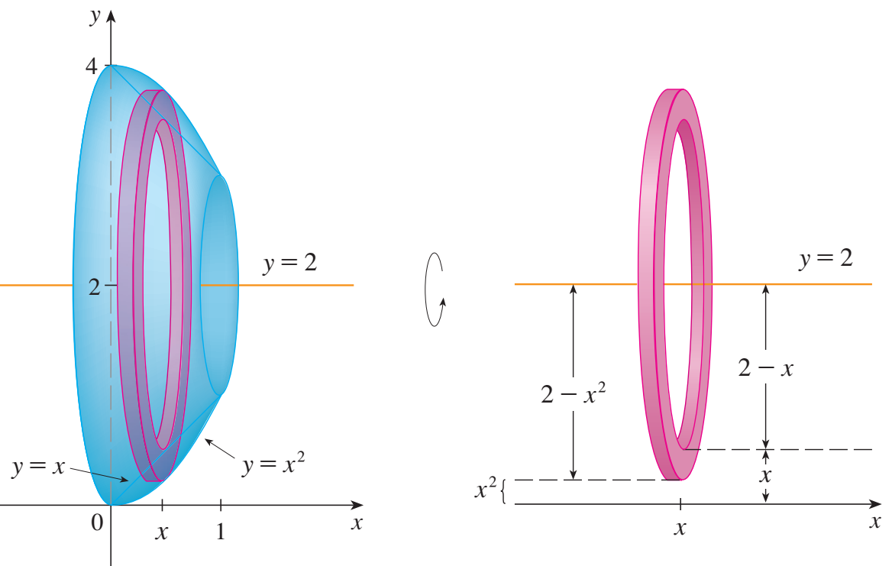
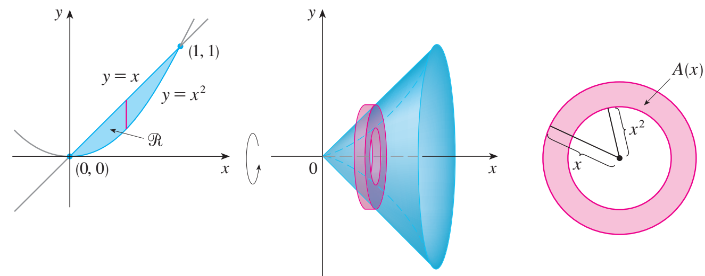
Washer Method: Examples
Let D is the region enclosed by the curves
y = x and y = x² is rotated about the x-axis. Find the volume of the resulting solid.

Slide 7
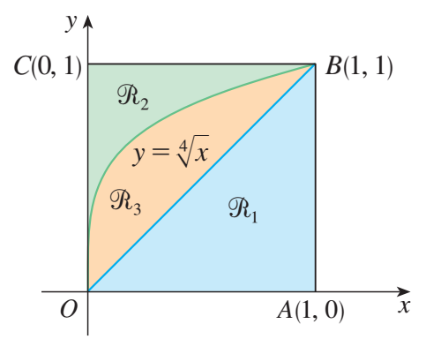
Exercises
Refer to the figure and find the volume generated by rotating the given region about the specified line.
a. R₁ about OA. b. R₁ about OC. c. R₁ about AB. d. R₁ about BC.
a. R₂ about OA. b. R₂ about OC. c. R₂ about AB. d. R₂ about BC.
a. R₃ about OA. b. R₃ about OC. c. R₃ about AB. d. R₃ about BC.

Slide 8

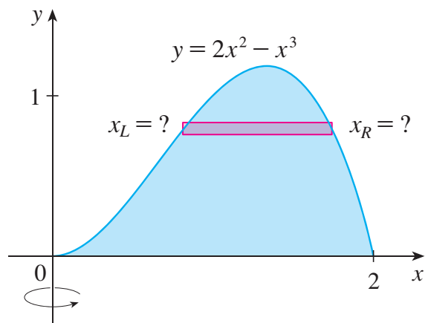
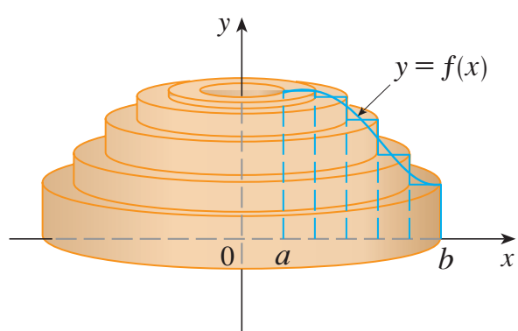
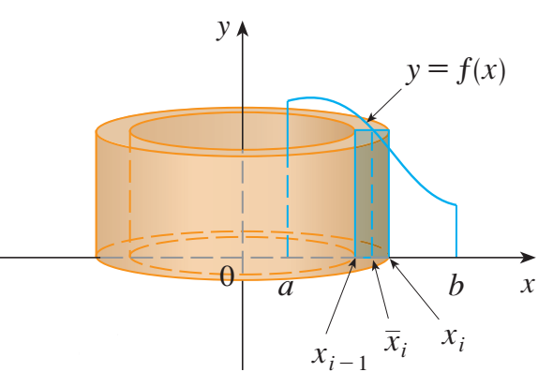
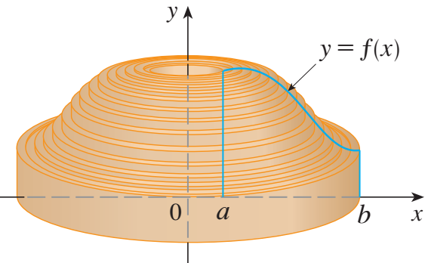
Cylindrical shells Method

Slide 9




Cylindrical shells Method

Slide 10


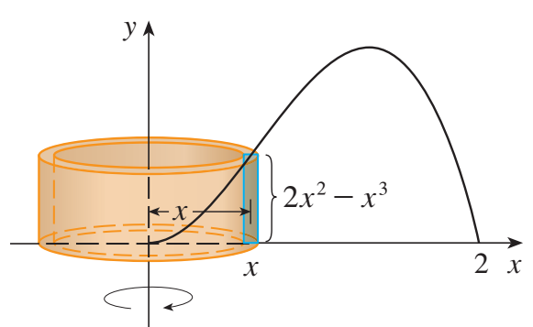
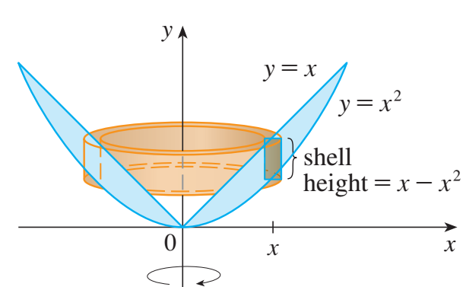
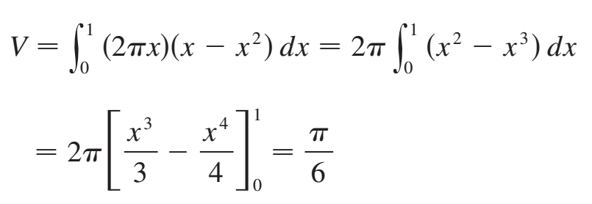
Examples

Slide 11
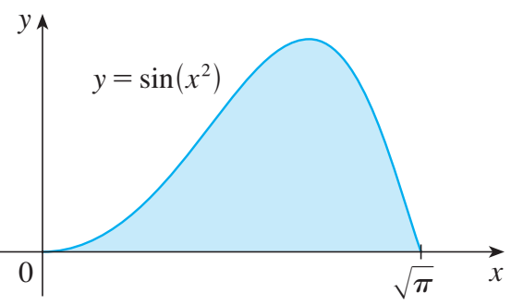
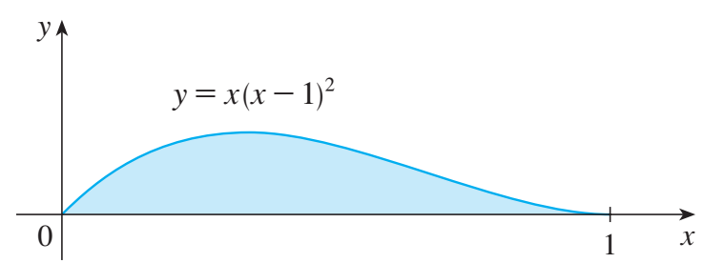

Exercies
Câu 1. Let D be the region under the curve $y=\sqrt{x}$ from 0 to 1. Find the volume of the solid obtained by rotating D about:
x-axis
The line $y=−2$
Câu 2. Rotating D about y-axis

